Slide 1
Interpreting a Variant Part 2 (Sequence)
Northwestern Genetic Counseling Lab Course
1/12/2024
Alexander Ing, MS, CGC

Slide 2
Lecture Roadmap
Evaluate
Evaluate the differences between the standard ACMG guidelines and other variant classification methods (e.g. Sherloc, ClinGen Expert Panels)
Examine
Examine the methodology of the 2015 ACMG Sequence Interpretation Guidelines
Apply
Apply the 2015 ACMG guidelines to data points to determine a variant classification
Construct
Construct variant interpretations from sample cases
Notes:
So in order to meet those objectives, heres a roadmap of how this lecture is going to go. First we will
Describe the technology and benefits/limitations of Next Generation Sequencing (NGS)
Then we will Compare the testing methodologies of Panel, Whole Exome Sequencing (WES) and Whole Genome Sequencing (WGS)
We will Summarize the American College of Medical Genetics and Genomics (ACMG) practice guidelines for WES/WGS
We will talk about where WES/WGS are relevant to you and your practice
Finally we will look at the bioinformatic components to NGS testing

Slide 3
Lecture Roadmap
Evaluate
Evaluate the differences between the standard ACMG guidelines and other variant classification methods (e.g. Sherloc, ClinGen Expert Panels)
Examine
Examine the methodology of the 2015 ACMG Sequence Interpretation Guidelines
Apply
Apply the 2015 ACMG guidelines to data points to determine a variant classification
Construct
Construct variant interpretations from sample cases
Notes:
So in order to meet those objectives, heres a roadmap of how this lecture is going to go. First we will
Describe the technology and benefits/limitations of Next Generation Sequencing (NGS)
Then we will Compare the testing methodologies of Panel, Whole Exome Sequencing (WES) and Whole Genome Sequencing (WGS)
We will Summarize the American College of Medical Genetics and Genomics (ACMG) practice guidelines for WES/WGS
We will talk about where WES/WGS are relevant to you and your practice
Finally we will look at the bioinformatic components to NGS testing

Slide 4
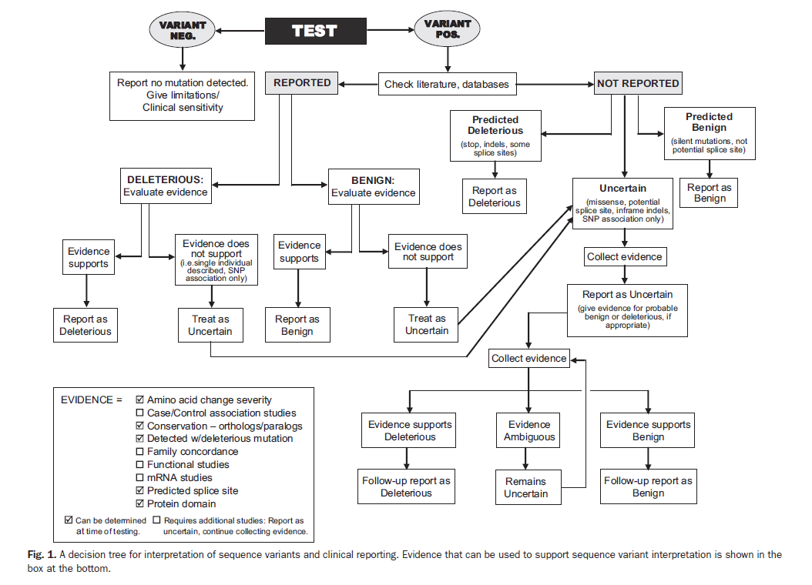
A Brief History of Variant Interpretation
Performing clinical NGS for more than a decade
First standards for sequence variant interpretation: 2000
Revisions in 2007
Provided interpretative categories and an algorithm for interpretation
Did NOT provide defined terms or detailed classification guidance
ACMG Laboratory Practice Committee Working Group. (2000). ACMG recommendations for standards for interpretation of sequence variations. Genetics in Medicine. 2(5). 302-303.
Richards, CS, et al. (2008). ACMG recommendations for standards for interpretation and reporting of sequence variations: Revisions 2007. Genetics in Medicine. 10(4). 294-300.
Notes:
2000 standards: 5 interpretative categories
2007 standards: 6 interpretative categories (based on whether or not it was a novel variant and whether or not evidence supports an impact)

Slide 5
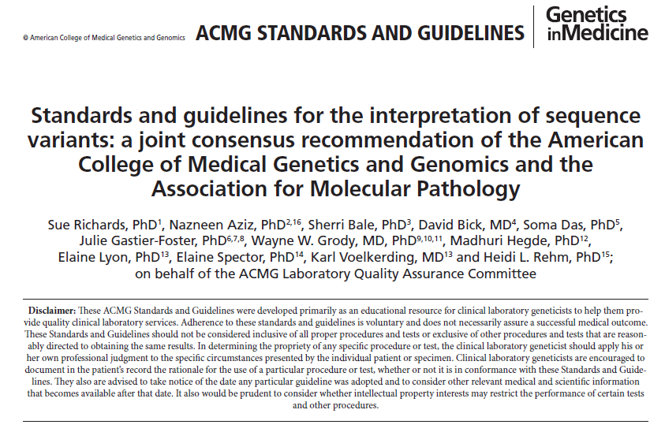
Richards, S., et al. (2015). Standards and guidelines for the interpretation of sequence variants: a joint consensus recommendation of the American College of Medical Genetics and Genomics and the Association for Molecular Pathology. Genetics in Medicine. 17(5). 405-424.

Slide 6
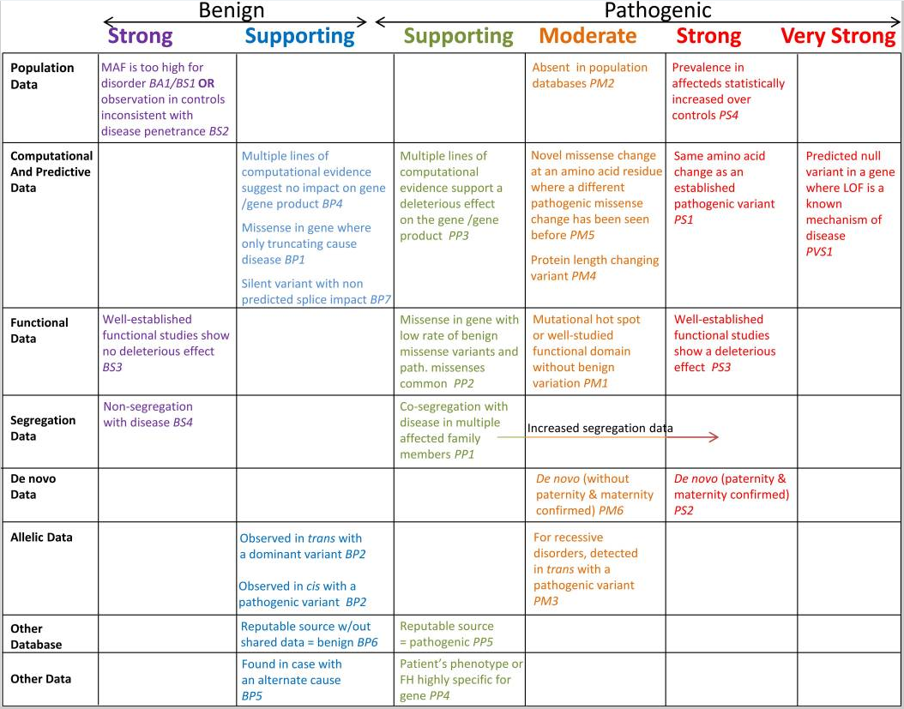
Criteria can be increased or decreased in strength
Don’t have to use criteria for every data point
Notes:
PVS1
Strong
Moderate
Supporting

Slide 7
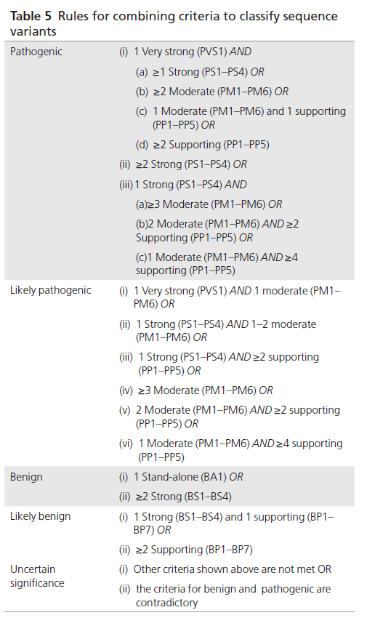
Semi-quantitative system
5-tier terminology system
Pathogenic, likely pathogenic, VUS, likely benign, benign
P/B variants = 100% certainty
LP/LB variants = 90% certainty
VUS = wide spectrum
Allows for compilation/weighing of evidence consistently across variants and across labs
Recommendations vs. rules
Individual interpretations of criteria may vary
Requires application of clinical judgment
Notes:
Variants of uncertain significance make up the largest range of variants; medical management changes should not be made based on VUS results.

Slide 8
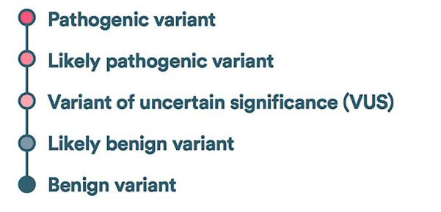
Variant Terminology
Mutation vs. polymorphism vs. variant
May lead to confusion/incorrect assumptions
Recommendation of using “variant” as a neutral term and adding modifiers
Notes:
Variant: any change to “normal” base pair sequence of the DNA
Polymorphism: DNA sequence changes that do not alter protein function; typically have an allele frequency of 1% or greater
Mutation: any change in the sequence of genomic DNA OR a pathogenic/disease-causing change

Slide 9
Lecture Roadmap
Evaluate
Evaluate the differences between the standard ACMG guidelines and other variant classification methods (e.g. Sherloc, ClinGen Expert Panels)
Examine
Examine the methodology of the 2015 ACMG Sequence Interpretation Guidelines
Apply
Apply the 2015 ACMG guidelines to data points to determine a variant classification
Construct
Construct variant interpretations from sample cases
Notes:
So in order to meet those objectives, heres a roadmap of how this lecture is going to go. First we will
Describe the technology and benefits/limitations of Next Generation Sequencing (NGS)
Then we will Compare the testing methodologies of Panel, Whole Exome Sequencing (WES) and Whole Genome Sequencing (WGS)
We will Summarize the American College of Medical Genetics and Genomics (ACMG) practice guidelines for WES/WGS
We will talk about where WES/WGS are relevant to you and your practice
Finally we will look at the bioinformatic components to NGS testing

Slide 10
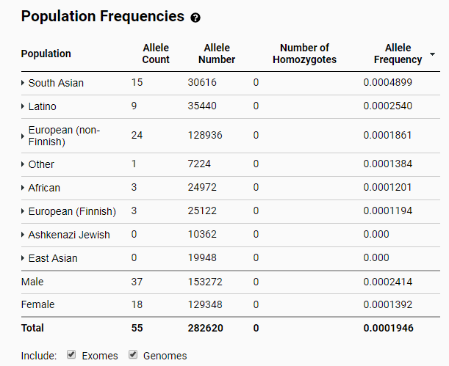
Population Data
Has the variant been seen in the general population?
https://gnomad.broadinstitute.org

Slide 11
Population Data
Considerations
Criteria
BA1 | Allele frequency is >5% ESP, 1000 Genomes Project, or ExAC
BS1 | Allele frequency is greater than expected for disorder
BS2 | Observed in a healthy adult individual for a recessive (homozygous), dominant (heterozygous), or X-linked (hemizygous) disorder, with full penetrance expected at an early age
PM2 | Absent from controls (or at an extremely low frequency if recessive) in ESP, 1000 Genomes Project, or ExAC
Frequency in sub-populations
What is benign in one population is presumably benign in all populations
Cut-offs often vary by lab
Ex: 0.1% (Invitae) vs. 0.5% (LMM) vs. 1% (Lurie)
Population databases may NOT contain only healthy individuals
Have to consider possibility of mild presentation, late onset, reduced penetrance
Notes:
Watch the denominator when using sub-populations! Ideally want at least 10,000 total alleles
Recognize limitations with data for certain ethnic backgrounds – a majority of control data comes from Caucasian populations

Slide 12
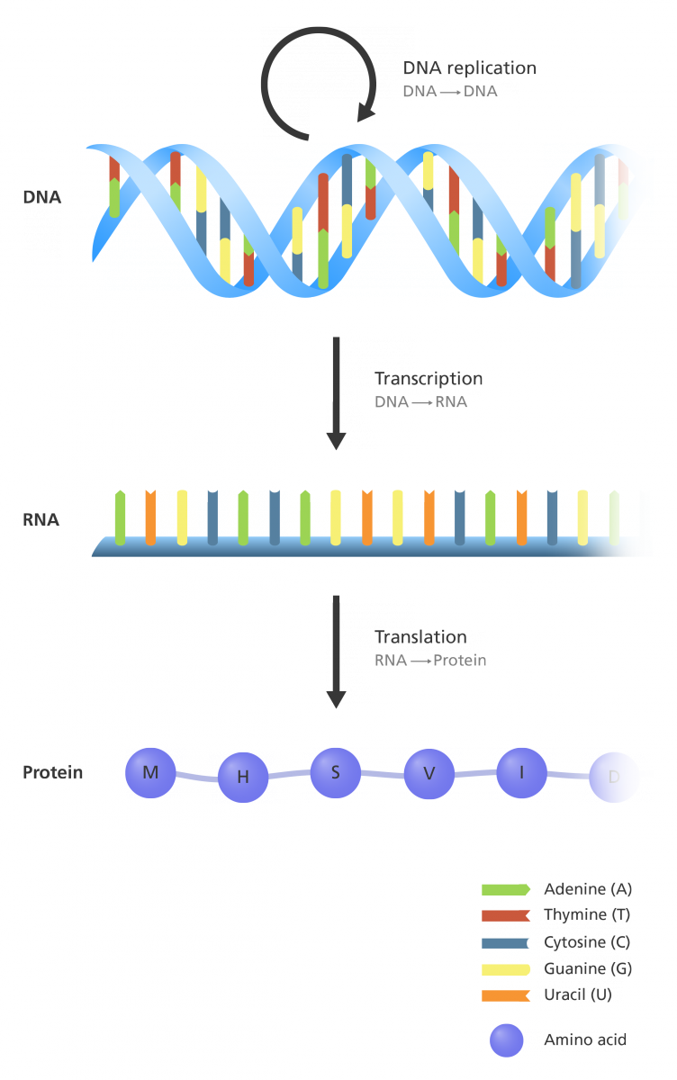
Impact to Protein
What is the expected impact of the variant on protein structure/function?
Different criteria are applicable depending on the impact of the variant on the protein
Null, missense, splicing, etc.
Consider the mechanism of disease for the gene
LOF, GOF, dominant-negative, etc.

Slide 13
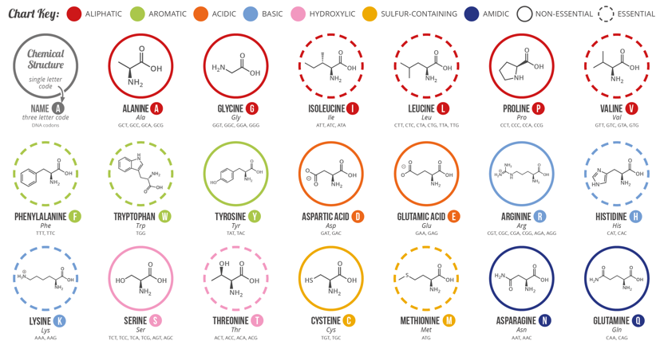
Impact to Protein - Missense
How different is the amino acid?

Slide 14
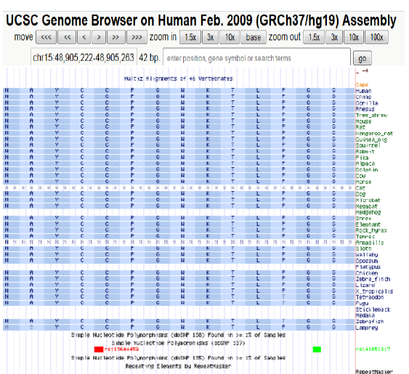
Impact to Protein - Missense
Is the variant amino acid conserved across species?
Notes:
Conserved amino acid across species (suggestive of pathogenic) VS. conservative amino acid change (suggestive of benign) – be careful with language

Slide 15
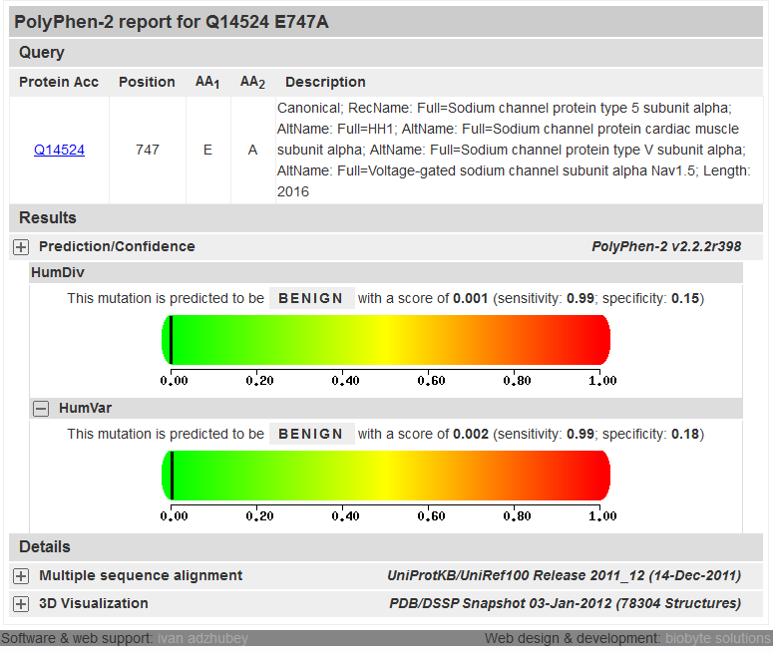
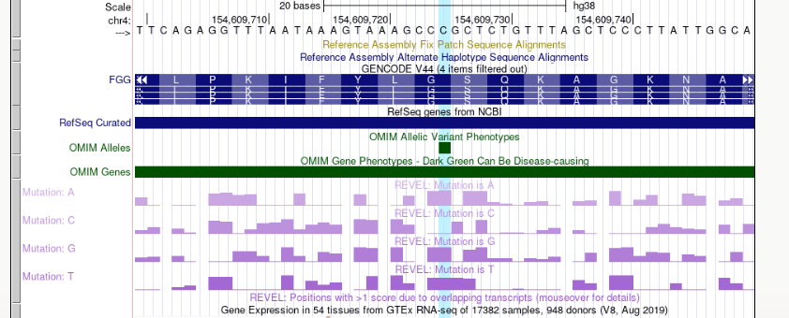
Impact to Protein - Missense
Do the in-silico tools predict an impact?
Tools have similarities in underlying basis of predictions
Each has its own strengths and weaknesses
Opt for meta-tools such as REVEL or CADD
Notes:
Study showed only 65-80% accuracy of in silico tools when applied to known disease variants. Have a tendency to over-predict a deleterious effect (not very specific)
Underlying basis: conservation, biochemical properties, location and context within the protein, or some combination of these things

Slide 16
Impact to Protein - Missense
In-silico Tools/Conservation
Mechanism of Disease
PP3 | Multiple lines of computational evidence support a deleterious effect on the gene or gene product (conservation, evolutionary, splicing impact, etc.)
BP4 | Multiple lines of computational evidence suggest no impact on gene or gene product (conservation, evolutionary, splicing impact, etc.)
PP2 | Missense variant in a gene that has a low rate of benign missense variation and in which missense variants are a common mechanism of disease Ex: RASopathies
BP1 | Missense variant in a gene for which primarily truncating variants are known to cause disease
For benchmarking purposes in REVEL
PP3 = <0.7
BP4 = >0.4
Pejaver V, Byrne AB, Feng BJ, Pagel KA, Mooney SD, Karchin R, O'Donnell-Luria A, Harrison SM, Tavtigian SV, Greenblatt MS, Biesecker LG, Radivojac P, Brenner SE; ClinGen Sequence Variant Interpretation Working Group. Calibration of computational tools for missense variant pathogenicity classification and ClinGen recommendations for PP3/BP4 criteria. Am J Hum Genet. 2022 Dec 1;109(12):2163-2177. doi: 10.1016/j.ajhg.2022.10.013. Epub 2022 Nov 21. PMID: 36413997; PMCID: PMC9748256.

Slide 17
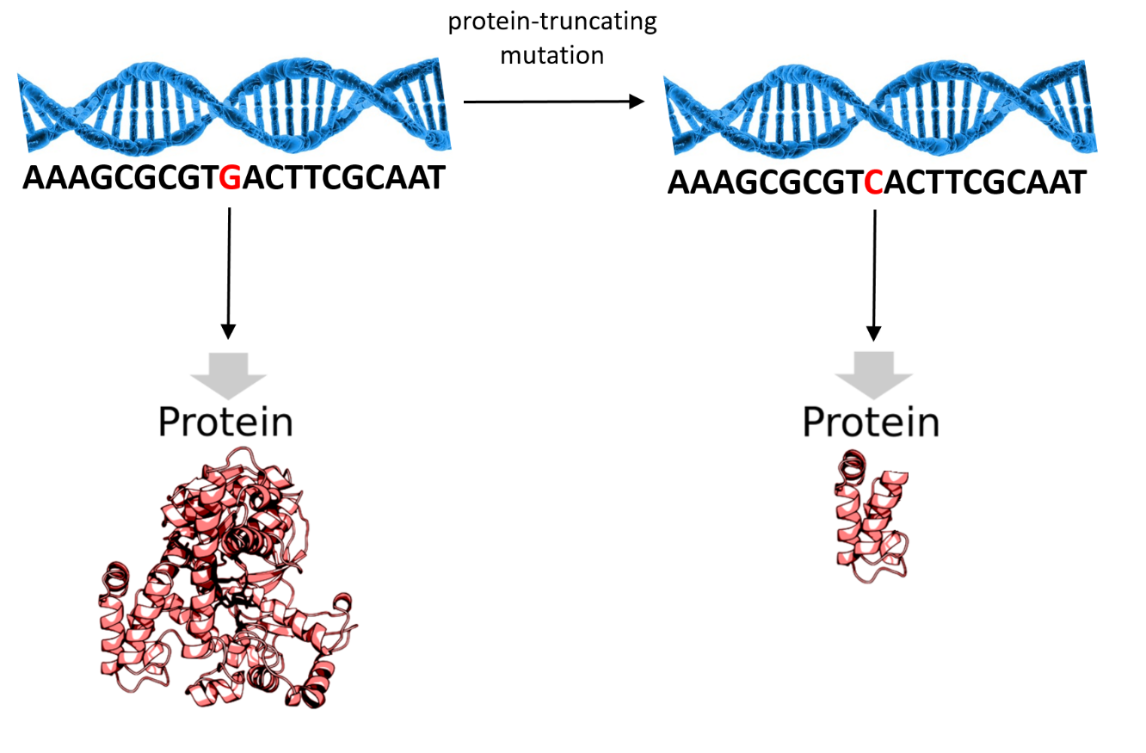
Impact to Protein - LOF
PVS1 | Null variant (nonsense, frameshift, canonical splice sites, initiation codon, single or multi-exon deletion) in a gene where LOF is a known mechanism of disease
Caveats:
LOF is not the mechanism of disease (e.g. MYH7)
Escapes NMD
Splice variants causing in-frame exon skipping
Alternate exon splicing with multiple transcripts

Slide 18
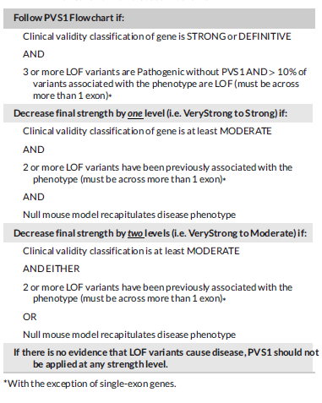
Caveats of LOF
Tayoun et al. (2018): working group through ClinGen to further refine how/when PVS1 should be applied
Determine if LOF is the mechanism of disease for a gene?

Slide 19
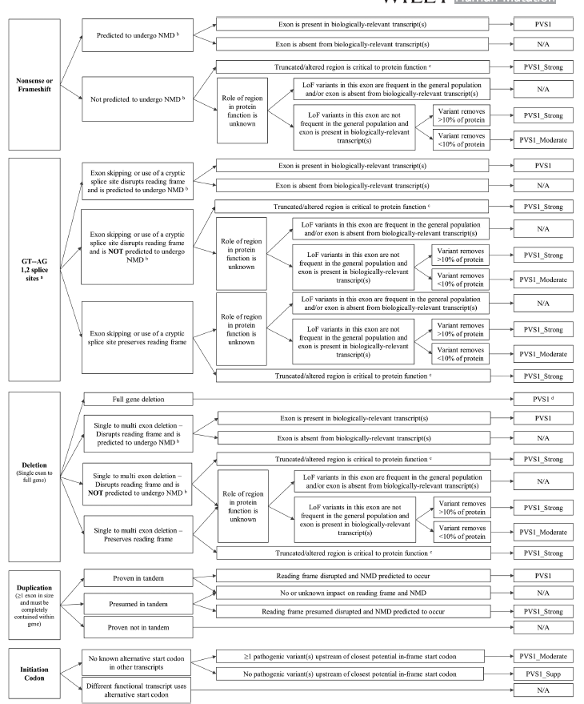
Determine the level of impact for a suspected LOF variant?
Decision tree allows for modification of strength of PVS1 based on specific circumstances
Do not double count evidence!
If you are using PVS1 or a variation of it, do not also use PM4, PP3
All are looking at impact to protein
Notes:
PM4 is inframe del/dup

Slide 20
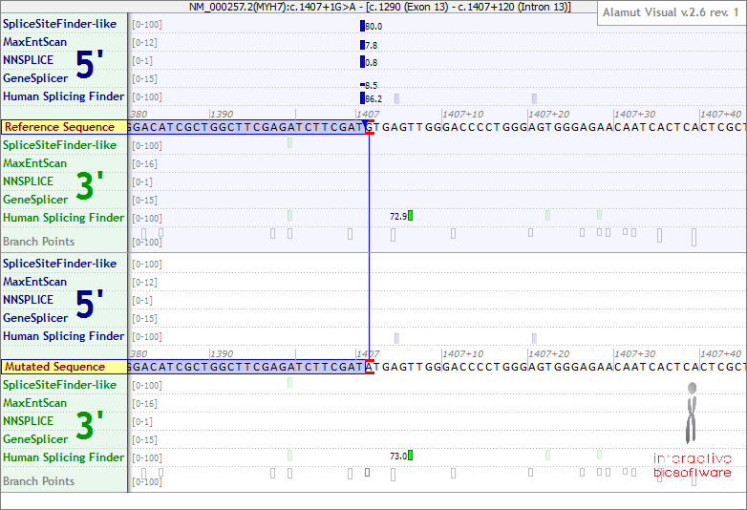
Impact to Protein - Splicing
Is it a canonical splice variant (+/- 1 or 2)?
PVS1
But consider caveats!
Is it outside of the canonical splice sites?
Look at splice prediction tools
Predicted splice impact across multiple tools: PP3
Ideally want transcriptional RNA studies to determine effect
Notes:
Splicing predictors have a higher sensitivity than in silico tools (90-100%). Again, use multiple at a time and consider them in aggregate as a single piece of evidence

Slide 21
Impact to Protein – In-Frame Del/Dup
PM4 | Protein length changes as a result of in-frame deletions/insertions in a non-repeat region OR as a result of a stop-loss variant The larger the del/dup and the more conserved the amino acids are, the higher the evidence to support pathogenicity Stop-loss variants: may lead to an elongated protein
BP3 | In-frame deletions/insertions in a repetitive region without a known function

Slide 22
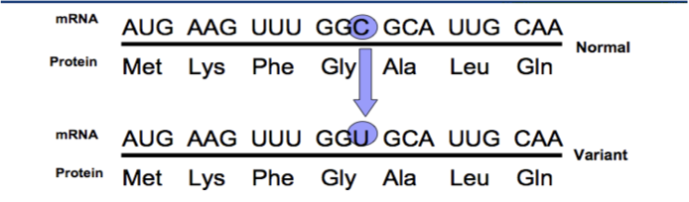
Impact to Protein - Synonymous
Oftentimes benign, as they do not impact the amino acid sequence
However, must consider conservation and predicted splice impact
BP7 | A synonymous (silent) variant for which splicing prediction algorithms predict no impact to the splice consensus nor the creation of a new splice site AND the nucleotide is not highly conserved
Notes:
Have to consider if nucleotide change could affect splicing (such as the last nucleotide of an exon), or affect binding properties, etc.

Slide 23
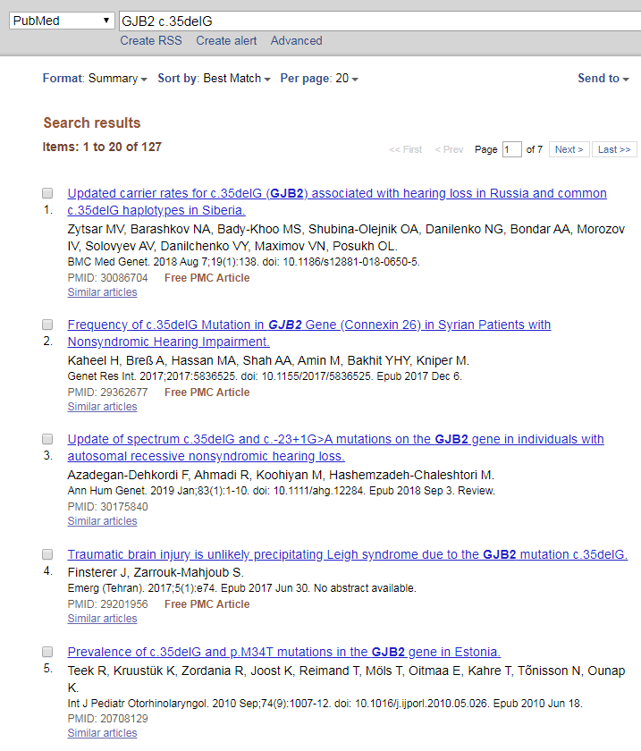
Proband Data
Has the variant been seen in affected probands?
Internally or in the literature
Variant databases: HGMD, LOVD, Google, PubMed, gene/disease specific databases (e.g. Rett, ARVC, DMD, TSC)

Slide 24
Proband Data
Criteria
Considerations
AKA “Proband counting”
What is the…
Clarity of pt phenotype
Scope of proband testing (i.e. single gene vs. exome)
Prevalence of the condition of interest (i.e. rare vs. common)
Watch for possible overlap in patients!
Modify strength based on counts
PS4 | The prevalence of the variant in affected individuals is significantly increased compared with the prevalence in controls Relative risk or OR is >5.0 and confidence interval does not include 1.0 For very rare variants: prior observation of the variant in multiple unrelated patients with the same phenotype

Slide 25
Calculation of Odds Ratios
OR = 1.0
Having the variant does not affect the odds of having the disease
OR > 1.0
There is some association between the variant and the risk of having the disease
OR > 3
The variant has a modest Mendelian effect on the risk of having the disease
Highly penetrant variants will have very high ORs
However, if Confidence Interval (CI) includes 1.0, there is little confidence in the assertion of association
Use cautiously for very rare variants!
https://www.easycalculation.com/statistics/odds-ratio.php
http://www.hutchon.net/ConfidOR.htm

Slide 26
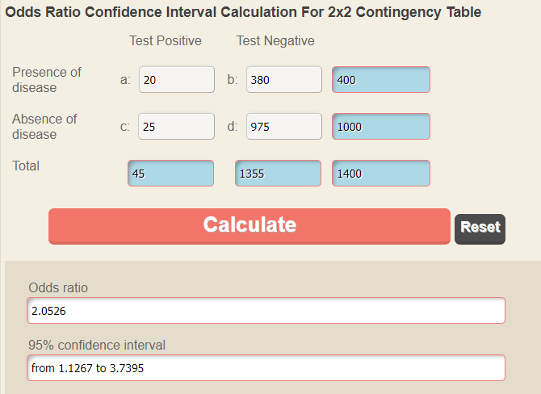
Calculation of Odds Ratios
Example:
Have a cohort of 400 individuals with disease X, of which 20 have your variant
Also have a cohort of 1000 healthy controls, of which 25 have your variant
OR ~ 2 with CI from ~1.1-3.7
Having the variant has some association with risk of having disease X, but does not appear to be a strong Mendelian effect

Slide 27
Proband Phenotype
Considerations
Criteria
Use sparingly! – nearly all patients undergoing disease-targeted testing have the phenotype in question
Good examples: Tay-Sach’s, Gorlin syndrome
Bad examples: CTDs, breast cancer, HCM
PP4 | Patient’s phenotype or family history is highly specific for a disease with a single genetic etiology
Notes:
Can use this if there is a high detection rate for the condition, the patient has well-defined features without overlap with other clinical presentations, and the gene is without substantial benign variation

Slide 28
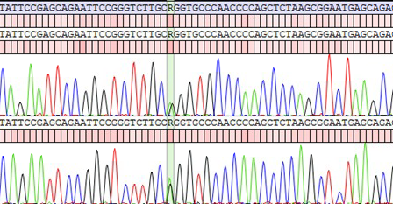
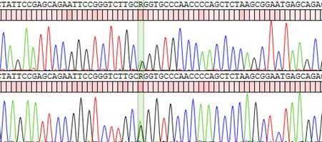
Parental Testing
Proband
Has parental testing been done?
In your patient or in the literature
Mother

Slide 29
Parental Testing
De Novo
Cis/Trans
PS2 | De novo (both maternity and paternity confirmed) in a patient with the disease and no family history
PM6 | Assumed de novo, but without confirmation of paternity and maternity
PM3 | For recessive disorders, detected in trans with a pathogenic variant
BP2 | Observed in trans with a pathogenic variant for a fully penetrant dominant gene/disorder or observed in cis with a pathogenic variant in any inheritance pattern
Can upgrade strength of PM6 if there are multiple instances of DNs in affected patients
Can upgrade strength of PM3 if there are multiple occurrences of the variant in trans with a path variant
Notes:
Make sure fhx is actually consistent with DN inheritance (but don’t forget about the small possibility of germline mosaicism if two sibs are affected)
Consider how the DN variant was detected (e.g. on panel vs on exome). Everyone has a handful of DN variants on exome
Once an allele is disrupted (has a pathogenic variant), there is no selective pressure preventing that allele from acquiring additional variants that would be pathogenic isolation

Slide 30
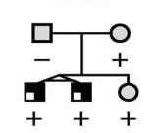
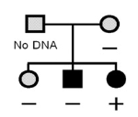
Segregations
Does the variant track with the pattern of disease in the family?
Not segregations
PP1 | Co-segregation with disease in multiple affected family members in a gene definitively known to cause the disease
BS4 | Lack of segregation in affected members of a family
Not a segregation
Can change weights based on number/strength of your segregations
A family member with the variant but without symptoms does NOT count as a segregation
Reduced penetrance, variable expressivity, etc.
Non-segregation
BS4

Slide 31
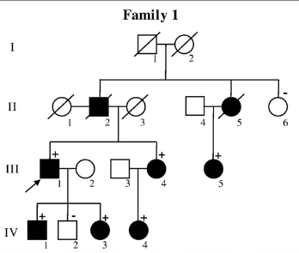
Segregation Statistics
Published statistical models
Take into account age-related penetrance and phenocopy rates
Utilize a Bayesian analysis model
Degrees of relatedness impact strength of the segregation
i.e. segregations with more distant relatives provide stronger statistical evidence than segregations with a first degree relative
Notes:
Ideally want segregations across multiple unrelated families
Need to make sure family members have had careful clinical evaluations to rule out mild symptoms of reportedly unaffected individuals, as well as possible phenocopies

Slide 32
Functional Data
PS3 | Well-established in vitro or in vivo functional studies supportive of a damaging effect on the gene or gene product
BS3 | Well-established in vitro or in vivo functional studies show no damaging effect on protein function or splicing
Are there published functional studies on this variant?
How closely does the assay reflect the biological environment?
In vivo vs. in vitro, human vs. animal
Want studies that are validated, reproducible, and robust
Notes:
Functional studies speak only indirectly to the question of pathogenicity. Only persuasive to the extent that the measured property is recapitulated in vivo and is relevant to the disease mechanism of the gene.
Experiments on human tissue from biopsy or animal models are stronger evidence than expressing the protein in in-vitro studies
Expression/structural studies are NOT counted the same as functional studies

Slide 33
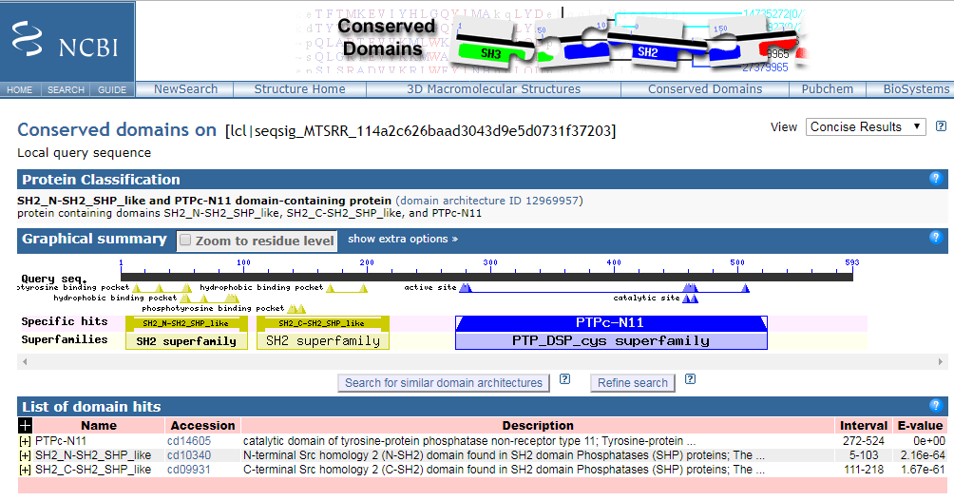
Mutational Hotspots
Is the variant within a known hotspot or functional domain?
PM1 | Located in a mutational hot spot and/or critical and well-established functional domain (e.g. active site of an enzyme) without benign variation
Examples:
Head region of MYH7
N-SH2 and PTP domains of PTPN11
A-band of TTN

Slide 34
Similar Variants
PS1 | Same amino acid change as a previously established pathogenic variant regardless of nucleotide change Ex: Val-Leu caused by G>C is pathogenic, now you are evaluating Val-Leu caused by G>T in the same codon
PM5 | Novel missense change at an amino acid residue where a different missense change determined to be pathogenic has been seen before Ex: Arg156His is pathogenic, now you are evaluating Arg156Cys
Have other variants at the same amino acid residue been published as disease-causing?
Make sure published variant is actually pathogenic before using these criteria!

Slide 35
Alternate Explanation of Disease
BP5 | Variant found in a case with an alternate molecular basis for disease
Has another variant been identified in the patient that clearly explains their disease phenotype?
Be careful of exceptions!
Carrier of an unrelated pathogenic variant
Multiple variants may lead to more severe disease
Conditions with multigenic inheritance

Slide 36
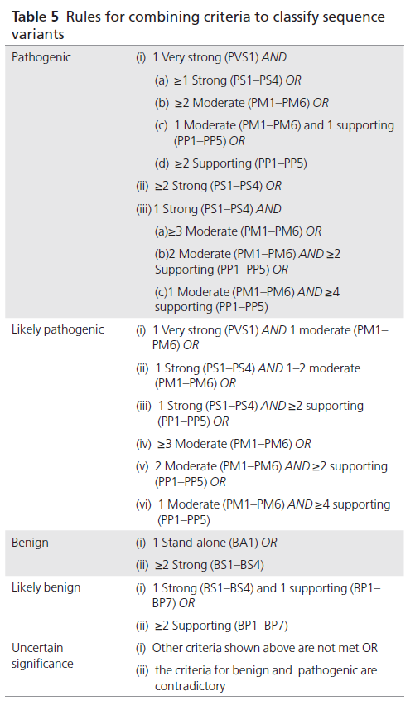
Determining a Final Classification
VUS
Not enough criteria to meet P/LP/B/LB OR
Pathogenic and benign criteria conflict
Ex: variant is absent from controls (PM2), but functional studies showed no impact to the protein (BS3)
Don’t double count evidence!
Judgment can be used to upgrade or downgrade criteria depending on evidence collected

Slide 37

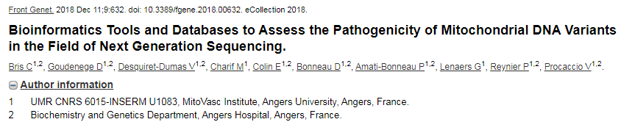
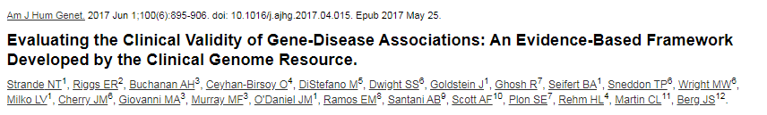
Additional Considerations
Somatic, pharmacogenomic, and mitochondrial variants
Genes of Uncertain Significance (GUS)
Common complex disorders/risk alleles

Slide 38
Lecture Roadmap
Evaluate
Evaluate the differences between the standard ACMG guidelines and other variant classification methods (e.g. Sherloc, ClinGen Expert Panels)
Examine
Examine the methodology of the 2015 ACMG Sequence Interpretation Guidelines
Apply
Apply the 2015 ACMG guidelines to data points to determine a variant classification
Construct
Construct variant interpretations from sample cases
Notes:
So in order to meet those objectives, heres a roadmap of how this lecture is going to go. First we will
Describe the technology and benefits/limitations of Next Generation Sequencing (NGS)
Then we will Compare the testing methodologies of Panel, Whole Exome Sequencing (WES) and Whole Genome Sequencing (WGS)
We will Summarize the American College of Medical Genetics and Genomics (ACMG) practice guidelines for WES/WGS
We will talk about where WES/WGS are relevant to you and your practice
Finally we will look at the bioinformatic components to NGS testing

Slide 39
Example 1
KMT2D
c.6664C>T
p.Q2222* (aka Gln2222X aka Gln2222Ter)
Chr12:49434889
Inheritance: autosomal dominant
Disease: Kabuki syndrome
Phenotype: developmental delay, microcephaly, seizures, hypotonia, dysmorphic facies

Slide 40
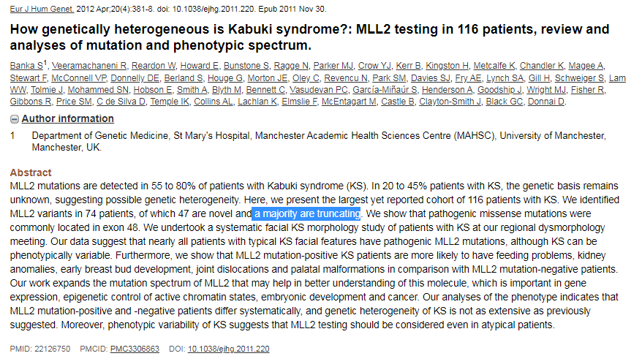
KMT2D c.6664C>T p.Q2222* Chr12:49434889
Is LOF a mechanism of disease?
What is the impact to the protein?
Criteria | Variant Evidence
PVS1 | Null variant in a gene where LOF is a mechanism of disease
Stop-gain variant, leads to truncated protein
In exon 31/54 (expected to undergo NMD)
Given this is a null variant, in-silico tools/conservation are not relevant
Notes:
One way to determine where in the protein a variant is: plug variant into UCSC browser and zoom out enough to see AA level. Hover over your amino acid to see which exon it is located in.
MLL2 = previous name for KMT2D

Slide 41
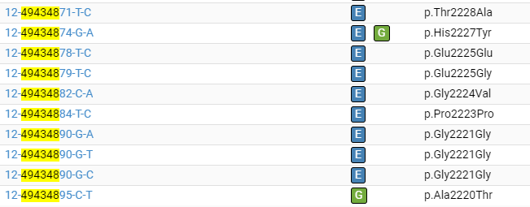
KMT2D c.6664C>T p.Q2222* Chr12:49434889
Is it in population databases?
Criteria | Variant Evidence
PVS1 | Null variant in a gene where LOF is a mechanism of disease
PM2 | Absent from gnomAD

Slide 42
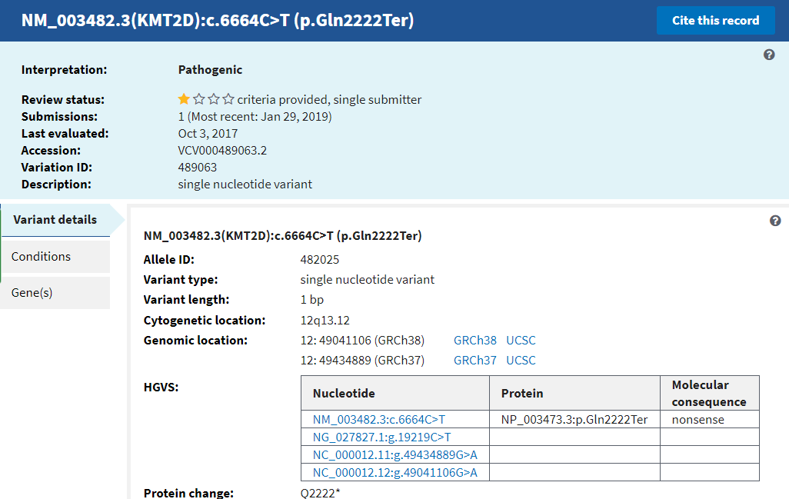
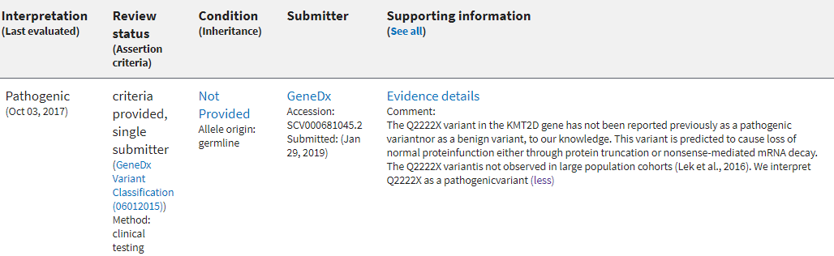
KMT2D c.6664C>T p.Q2222* Chr12:49434889
Is it reported by other labs in ClinVar?
Criteria | Variant Evidence
PVS1 | Null variant in a gene where LOF is a mechanism of disease
PM2 | Absent from gnomAD
N/a | Called pathogenic in ClinVar by one lab

Slide 43
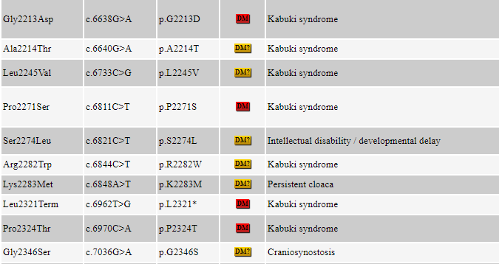
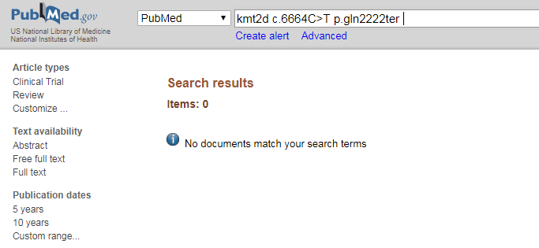
KMT2D c.6664C>T p.Q2222* Chr12:49434889
Is it reported in the literature?
Criteria | Variant Evidence
PVS1 | Null variant in a gene where LOF is a mechanism of disease
PM2 | Absent from gnomAD
N/a | Called pathogenic in ClinVar by one lab
N/a | Not published in the literature

Slide 44
KMT2D c.6664C>T p.Q2222* Chr12:49434889
Criteria | Variant Evidence
PVS1 | Null variant in a gene where LOF is a mechanism of disease
PM2 | Absent from gnomAD
N/a | Called pathogenic in ClinVar by one lab
N/a | Not published in the literature
Final Classification: likely pathogenic
What additional studies would you recommend for your patient?

Slide 45
KMT2D c.6664C>T p.Q2222* Chr12:49434889
Subsequent parental sequencing revealed that this variant was de novo in the proband
Criteria | Variant Evidence
PVS1 | Null variant in a gene where LOF is a mechanism of disease
PM2 | Absent from gnomAD
N/a | Called pathogenic in ClinVar by one lab
N/a | Not published in the literature
PM6 | Assumed de novo, without confirmation of maternity/paternity
Updated Classification: pathogenic

Slide 46
Example 2
KCNH2
c.2592+3G>A
p.?
Chr7:150645941
Inheritance: autosomal dominant
Disease: Long QT syndrome type 2
Phenotype: prolonged QT interval on EKG, syncope, sudden cardiac death

Slide 47
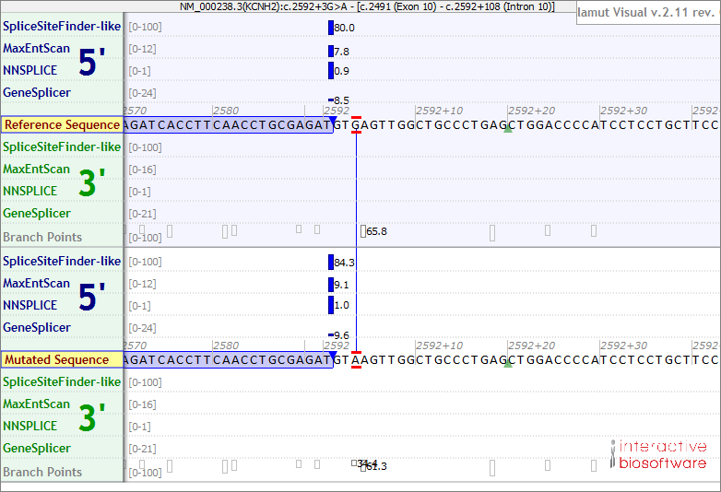
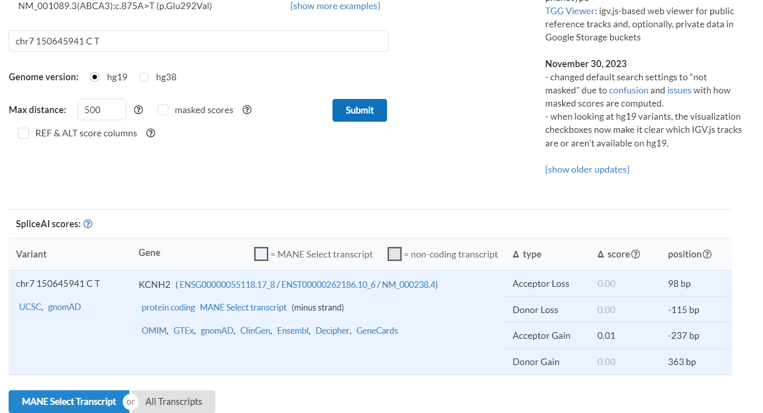
KCNH2 c.2592+3G>A p.? Chr7:150645941
What is the impact to the protein?
Criteria | Variant Evidence
N/a | Non-canonical splice variant not predicted to impact splicing
Not a canonical splice variant
Splice prediction tools: no impact to splicing
This is not expected to be a LOF variant; neither PVS1 nor PP3 are appropriate to use here

Slide 48
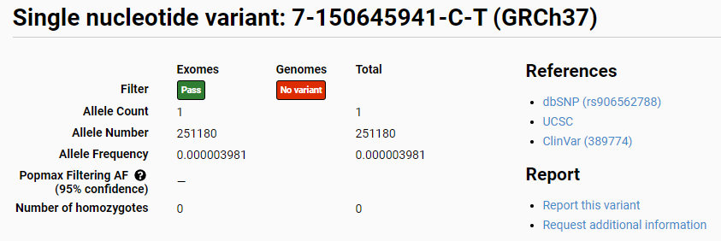
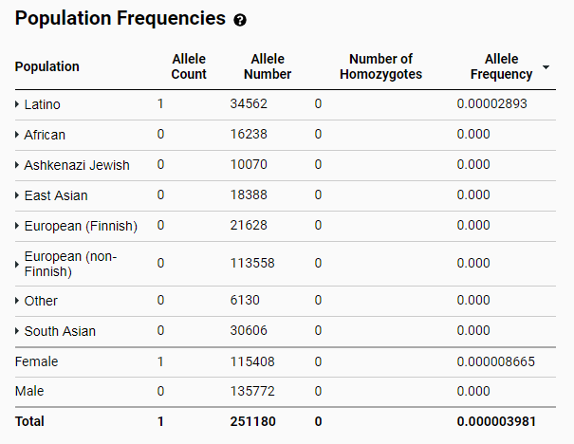
KCNH2 c.2592+3G>A p.? Chr7:150645941
Is it in population databases?
Criteria | Variant Evidence
N/a | Non-canonical splice variant not predicted to impact splicing
PM2 | In 0.002% (1/34562) of Latino alleles in gnomAD; very low frequency

Slide 49
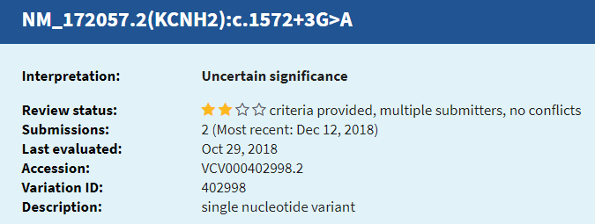
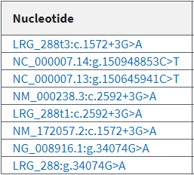
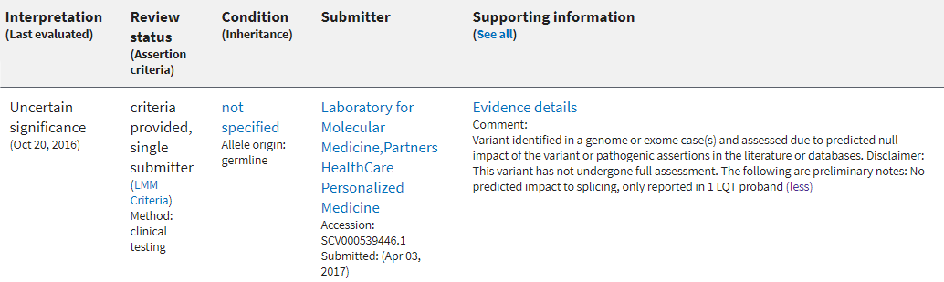
KCNH2 c.2592+3G>A p.? Chr7:150645941
Is it reported by other labs in ClinVar?
Nomenclature is different because ClinVar reports on a different transcript
Criteria | Variant Evidence
N/a | Non-canonical splice variant not predicted to impact splicing
PM2 | In 0.002% (1/34562) of Latino alleles in gnomAD; very low frequency
N/a | Called a VUS in ClinVar by one other lab

Slide 50
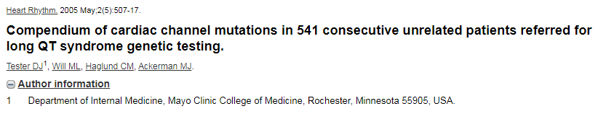
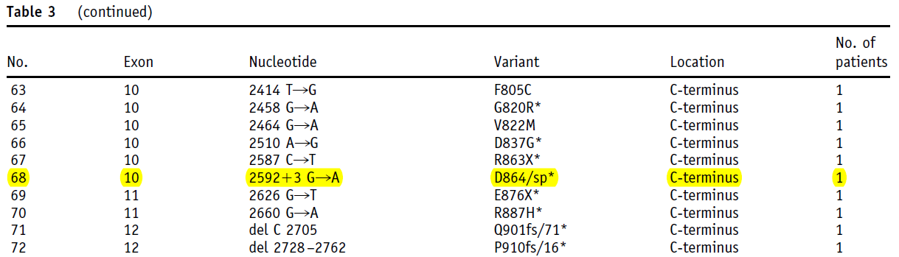
KCNH2 c.2592+3G>A p.? Chr7:150645941
Paper | Summary
Tester et al. (2005) | Sequenced the 5 most common LQTS genes in 541 probands with a clinical suspicion of LQTS. This variant was identified in one proband.
Is it reported in the literature?
Criteria | Variant Evidence
N/a | Non-canonical splice variant not predicted to impact splicing
PM2 | In 0.002% (1/34562) of Latino alleles in gnomAD; very low frequency
N/a | Called a VUS in ClinVar by one other lab
N/a | Identified in the literature in one proband with LQTS

Slide 51
KCNH2 c.2592+3G>A p.? Chr7:150645941
Criteria | Variant Evidence
N/a | Non-canonical splice variant not predicted to impact splicing
PM2 | In 0.002% (1/34562) of Latino alleles in gnomAD; very low frequency
N/a | Called a VUS in ClinVar by one other lab
N/a | Identified in the literature in one proband with LQTS
Final Classification: VUS

Slide 52
Example 3
GJB2
c.176_191del
p.Gly59Alafs*18
Chr13:20763530-20763545
Inheritance: autosomal recessive
Disease: nonsyndromic hearing loss
Phenotype: prelingual profound sensorineural hearing loss

Slide 53
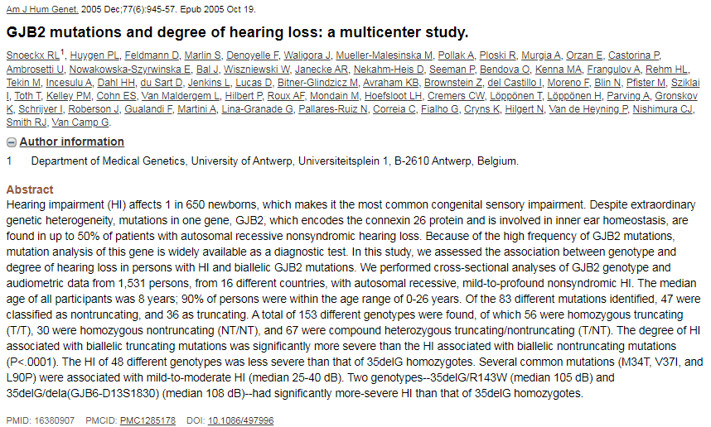
GJB2 c.176_191del p.Gly59Alafs*18 Chr13:20763530-20763545
Is LOF a mechanism of disease?
What is the impact to the protein?
Criteria | Variant Evidence
PVS1 | Null variant in a gene where LOF is a mechanism of disease
16 bp deletion, leads to premature stop codon 18 AA downstream
In exon 2/2 (BUT still expected to undergo NMD)
Given this is a null variant, in-silico tools/conservation are not relevant
Notes:
To determine if this is expected to undergo NMD or not, you can look to see if other null variants downstream of this variant are reported as pathogenic in ClinVar.

Slide 54
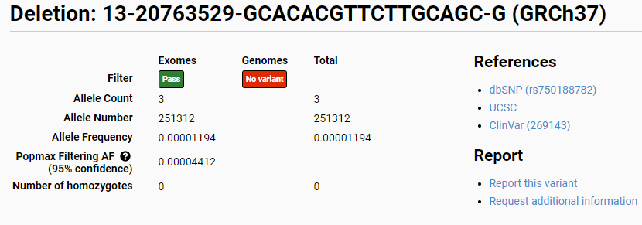
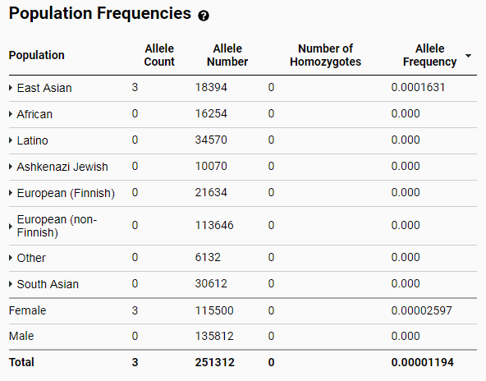
GJB2 c.176_191del p.Gly59Alafs*18 Chr13:20763530-20763545
Is it in population databases?
Criteria | Variant Evidence
PVS1 | Null variant in a gene where LOF is a mechanism of disease
PM2 | In 0.01% (3/18394) of East Asian alleles in gnomAD; very low frequency for an AR condition

Slide 55
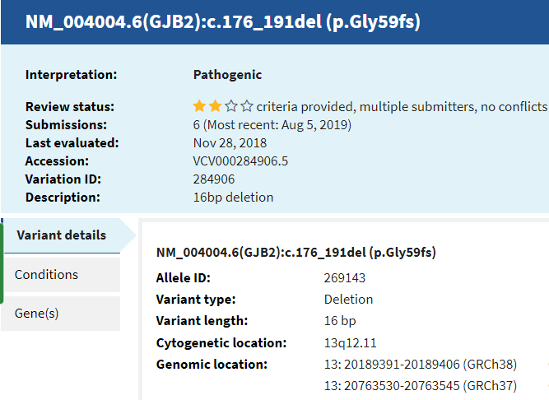
GJB2 c.176_191del p.Gly59Alafs*18 Chr13:20763530-20763545
Is it reported by other labs in ClinVar?
Criteria | Variant Evidence
PVS1 | Null variant in a gene where LOF is a mechanism of disease
PM2 | In 0.01% (3/18394) of East Asian alleles in gnomAD; very low frequency for an AR condition

Slide 56
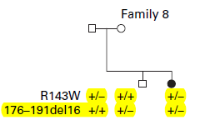
GJB2 c.176_191del p.Gly59Alafs*18 Chr13:20763530-20763545
Abe et al. (2000):
Is it reported in the literature?
Paper | Summary
Abe et al. (2000) | Sequenced GJB2 in 35 with bilateral SNHL. This variant was identified in one individual with HL who also carried the p.Arg143Trp variant. Parental testing was completed and confirmed the two variants to be in trans
Zhang et al. (2010) | In vitro functional studies looking at intracellular distribution of connexin-26 protein in transfected HEK-293 cells. Results suggested that this variant cannot form gap junctions and that the mutant protein was trapped in the ER
Davoudi-Dehaghar et al. (2014) | Case report of a 12 yo with congenital HL who was identified to have this variant as well as another GJB2 variant (c.327_328delGGinsA). Parental testing confirmed the variants to be in trans.
Criteria | Variant Evidence
PVS1 | Null variant in a gene where LOF is a mechanism of disease
PM2 | In 0.01% (3/18394) of East Asian alleles in gnomAD; very low frequency for an AR condition
N/a | Identified in the literature in 2 probands with HL
PM3_ Strong | Identified in trans with a pathogenic variant (AR disorder) [in two unrelated pts]
PS3 | Functional study demonstrates a damaging effect
Notes:
It is present but not enough for us to start counting probands
Found Trans

Slide 57
GJB2 c.176_191del p.Gly59Alafs*18 Chr13:20763530-20763545
Criteria | Variant Evidence
PVS1 | Null variant in a gene where LOF is a mechanism of disease
PM2 | In 0.01% (3/18394) of East Asian alleles in gnomAD; very low frequency for an AR condition
PP5 | Called pathogenic by 6 reputable labs in ClinVar
N/a | Identified in the literature in 2 probands with HL
PM3_ Strong | Identified in trans with a pathogenic variant (AR disorder) [in two unrelated pts]
PS3 | Functional study demonstrates a damaging effect
Final Classification: pathogenic

Slide 58
Example 4
SCN2A
c.5753G>A
p.Arg1918His
Chr2:166246069
Inheritance: autosomal dominant
Disease: early infantile epileptic encephalopathy
Phenotype: tonic-clonic seizures, abnormal EEG, developmental delays

Slide 59
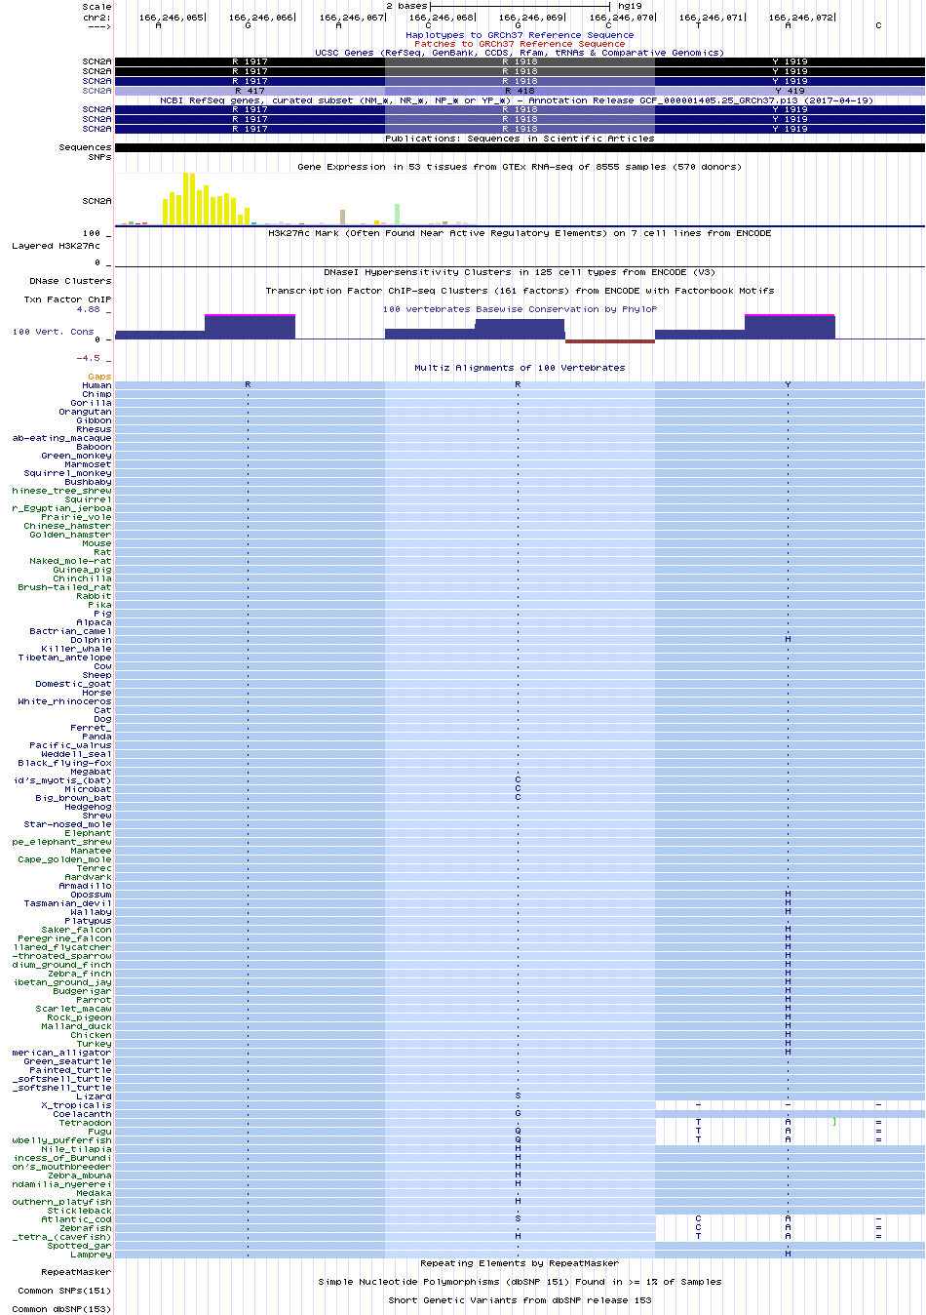
SCN2A c.5753G>A p.Arg1918His Chr2:166246069
What is the impact to the protein?
Missense variant
Conserved across primates and most mammals
Some variation in bat and fish species
7 fish species that have our variant AA (His) as their wildtype

Slide 60
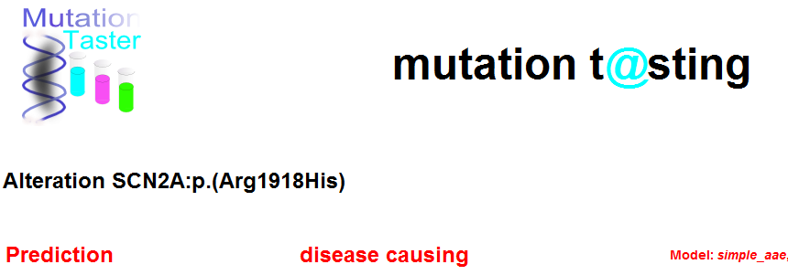
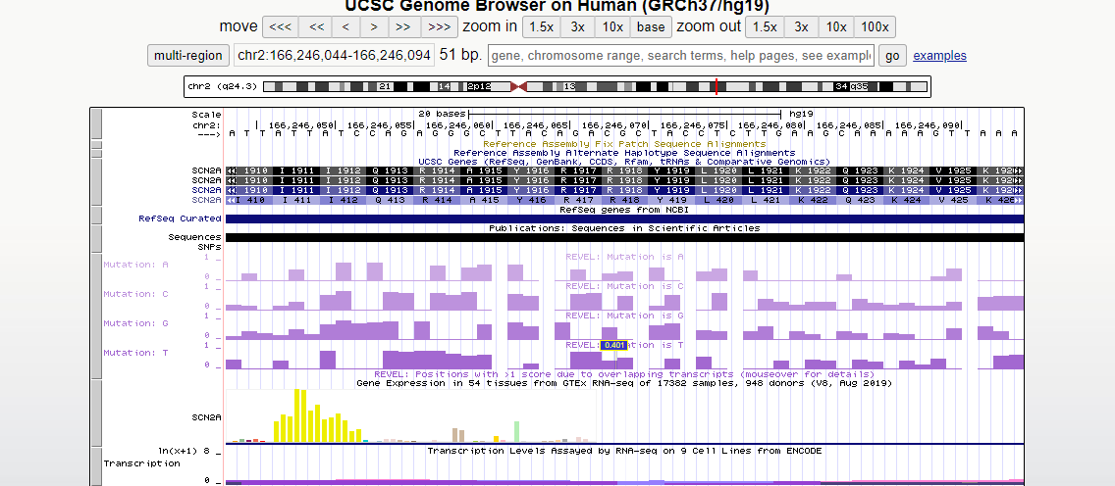


SCN2A c.5753G>A p.Arg1918His Chr2:166246069
What is the impact to the protein?
In silico tools borderline/unclear
Criteria | Variant Evidence
N/a | In-silico tools and conservation are unclear

Slide 61


SCN2A c.5753G>A p.Arg1918His Chr2:166246069
Is it in population databases?
Criteria | Variant Evidence
N/a | In-silico tools and conservation are unclear
N/a | In 0.01% (19/128484) of East European alleles in gnomAD

Slide 62

SCN2A c.5753G>A p.Arg1918His Chr2:166246069
Is it reported by other labs in ClinVar?
Criteria | Variant Evidence
N/a | In-silico tools and conservation are unclear
N/a | In 0.01% (19/128484) of East European alleles in gnomAD
N/a | Called a VUS by two labs in ClinVar

Slide 63

SCN2A c.5753G>A p.Arg1918His Chr2:166246069
Is it reported in the literature?
Criteria | Variant Evidence
N/a | In-silico tools and conservation are unclear
N/a | In 0.01% (19/128484) of East European alleles in gnomAD
N/a | Called a VUS by two labs in ClinVar
N/a | Reported in the literature in one proband with generalized epilepsy
BS4 | Non-segregation in an affected family member
Paper | Summary
Huang et al. (2001) | Sequenced SCN2A in 46 unrelated patients with idiopathic generalized epilepsy. This variant was identified in one proband with generalized tonic-clonic seizures, but was absent from an affected niece
Notes:
CAE: childhood absence epilepsy
FC: febrile convulsions

Slide 64
SCN2A c.5753G>A p.Arg1918His Chr2:166246069
Criteria | Variant Evidence
N/a | In-silico tools and conservation are unclear
N/a | In 0.01% (19/128484) of East European alleles in gnomAD
N/a | Called a VUS by two labs in ClinVar
N/a | Reported in the literature in one proband with generalized epilepsy
BS4 | Non-segregation in an affected family member
Final Classification: VUS

